Slide 1


Telecom Churn Case Study
Submitted by: Khushi Vora
Neha Vinod Nair
Gyanender Sindhu

Slide 2
Problem Statement
Telecom industry characterized by high competition and annual churn rates of 15-25%.
Acquiring new customers costs 5-10 times more than retaining existing ones, emphasizing the importance of customer retention.
Retaining high-profit customers is a top priority for many incumbent operators.
Key project goal: Analyze customer-level data of a leading telecom firm to build predictive models for identifying high-risk churn customers.
Objective: Identify main indicators of churn to inform retention strategies.
Approach:
Analyze customer-level data.
Build predictive models to identify high-risk churn customers.
Importance of churn prediction:
Allows proactive measures to retain customers.
Helps optimize resource allocation for retention efforts.
Outcome: Development of strategies focused on retaining high-value customers and reducing churn rates.

Slide 3
Objectives
To predict Customer Churn rate
Finding the main variables/factors influencing Customer Churn
ML algorithms to build prediction models, evaluate the accuracy and performance of the models- Decision Tree, random forest, Logistic Regression.
Finding out the best model for our business case and providing executive suggestions.

Slide 4
Steps
Business Understanding
Data Reading and Understanding
EDA
Data Preparation
Building Models
Validating the performace of Models
Conclusion

Slide 5
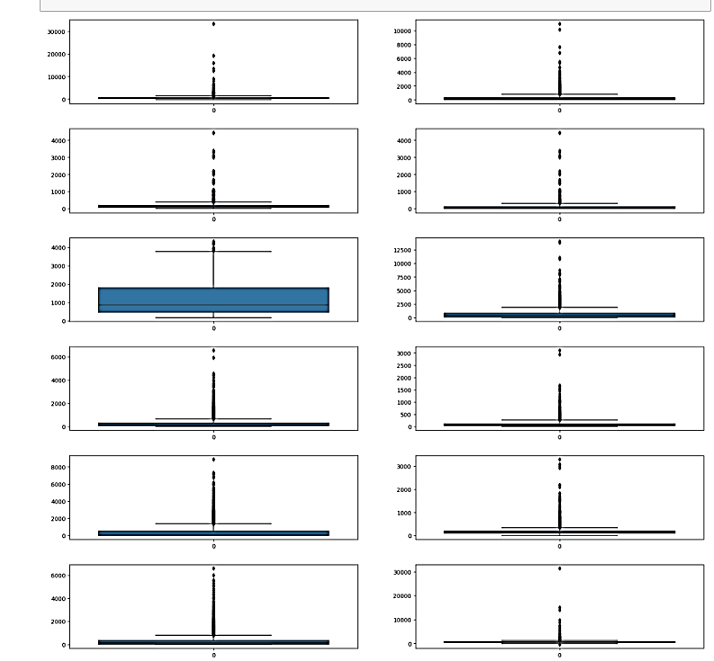
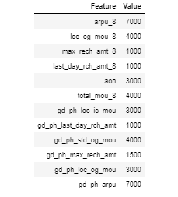
EDA
From the plots we can define following upper limits to the suspected variables

Slide 6
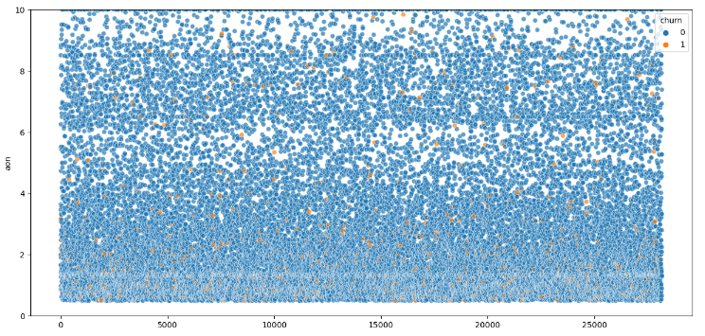
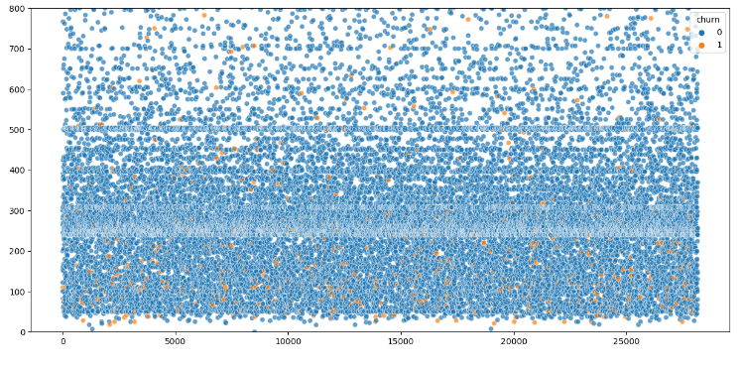
Churn based on tenure
Effect of max recharge amount on churn
Though we cannot see a clear pattern here, but we can notice that the majority of churners had a tenure of less than 4 years
We can see that users who had the max recharge amount less the 200 churned more

Slide 7
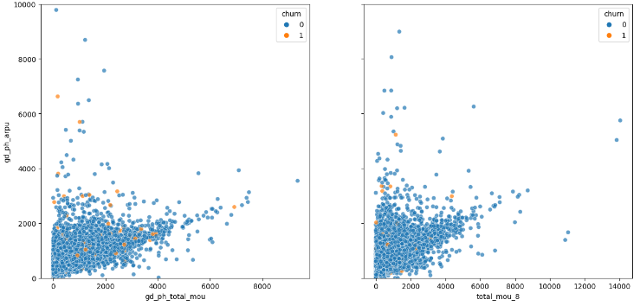
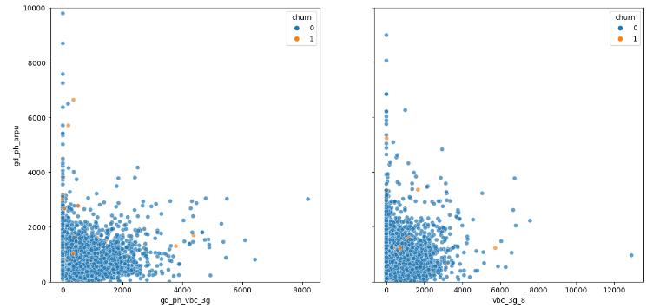
VBC effects the revenue
The total_mou effects the revenue
As we can observe that MOU is dropping significantly for churners in action phase which hitting the revenue generation. But then also revenue is higher in that part which indicates that the users are taking other services which increasing the revenue generation.
As we can see users using less amount of VBC generating high revenue churned and also revenue is higher from less consumption part.

Slide 8
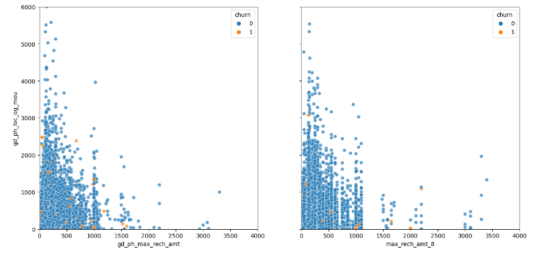
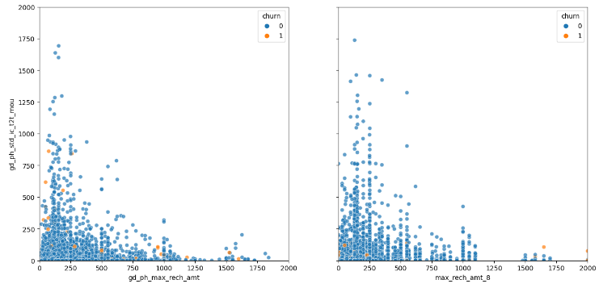
Recharge amount vs local outgoing calls
Service provider vs the recharge amount
Users who were recharging with high amounts were using the service for local uses less as compared to user who did lesser amounts of recharge and people whose max recharge amount as well as local out going were very less even in the good phase churned more.
Users who have max recharge amount on the higher end and still have low incoming call mou during the good phase, churned out more

Slide 9
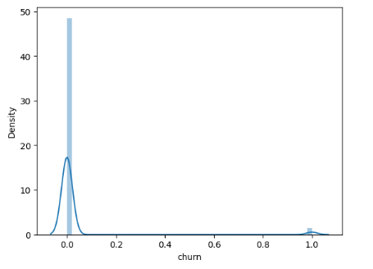
Distribution of target variable
As we can see that it is not skewed but highly imbalanced. The number of non churners are very high. so we will handle this using SMOTE.

Slide 10
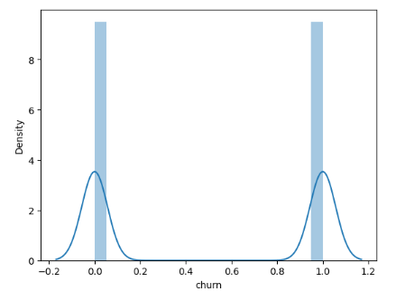
Handling class imbalance using SMOTE
We can see now target is not skewed and class is balance.

Slide 11
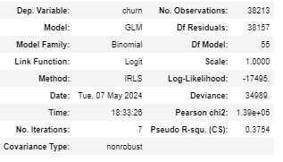
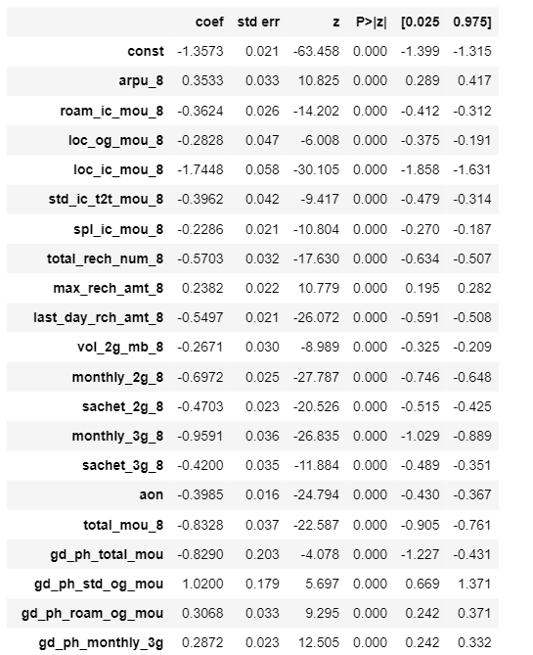
Model Building
1. Logistic Regression using RFE

Slide 12
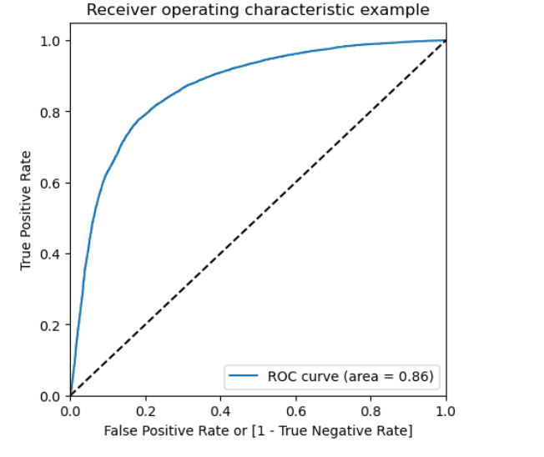
ROC Plotting

Slide 13
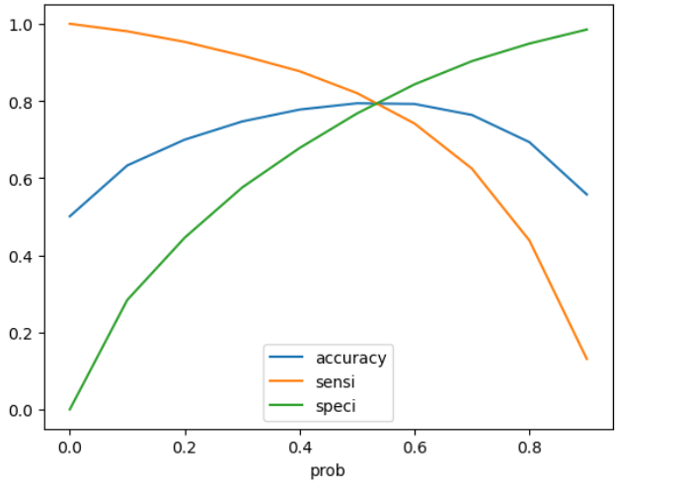
Optimal Cutoff
As we can see optimal cutoff is 0.5 so we will keep it

Slide 14
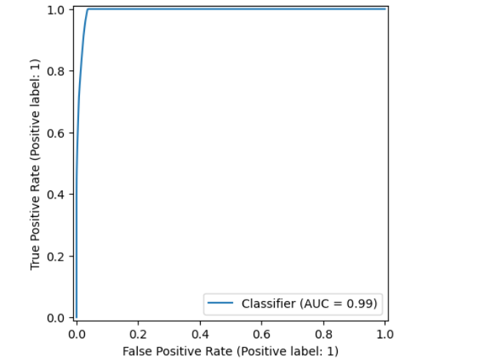
Decision Tree
ROC curve using hyperparameter tunning
With Decision Tree, we are getting 89% accuracy.

Slide 15
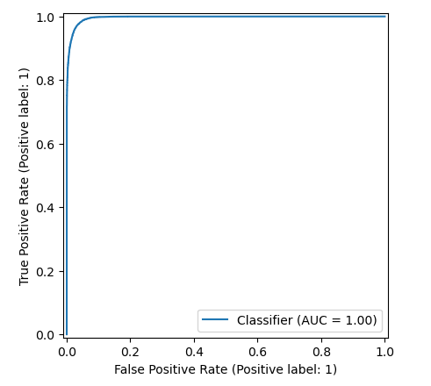
Random Forest
ROC curve using hyperparameter tunning
With Random Forest, we are getting 94% accuracy

Slide 16
Business Insights
In our effort to retain customers, prioritizing recall is crucial. Identifying customers at risk of churn (true positives) is paramount, as it allows us to intervene effectively and prevent customer loss. This approach minimizes the cost associated with losing a customer and acquiring new ones.
Upon evaluating the trained models, we've observed that the tuned Random Forest model outperforms others, boasting the highest accuracy and recall rates at 94%. Therefore, selecting the Random Forest model aligns with our objective of maximizing customer retention effectiveness.

Slide 17
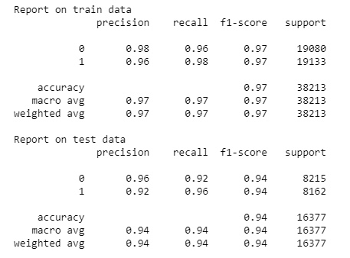
Final Model
We can see most of the top predictors are from the action phase, as the drop in engagement is prominent in that phase
Some of the factors we noticed while performing EDA which can be clubbed with these insights are:
i) Users whose maximum recharge amount is less than 200 even in the good phase, should have a tag and re-evaluated time to time as they are more likely to churn
ii) Users that have been with the network less than 4 years, should be monitored time to time, as from data we can see that users who have been associated with the network for less than 4 years tend to churn more.
MOU is one of the major factors, but data especially VBC if the user is not using a data pack if another factor to look out

Slide 18
Conclusion
Telecom company needs to pay attention to the roaming rates. They need to provide good offers to the customers who are using services from a roaming zone.
The company needs to focus on the STD and ISD rates. Perhaps, the rates are too high. Provide them with some kind of STD and ISD packages.
To look into both of the issues stated above, it is desired that the telecom company collects customer query and complaint data and work on their services according to the needs of customers.

